Slide 1
Automated Measurement of Surf Clam Growth Rings from Shell Images
Heng Lian
05/28/2026

Slide 2
Surf Clam Growth Rings Record Growth History
Surf clam shells contain visible growth rings that preserve the animal’s growth history over time.
Wide spacing between rings
→ faster shell growth
→ potentially favorable conditions
Narrow spacing between rings
→ slower shell growth
→ potentially stressful or unfavorable conditions
Notes:
Surf clam shells have visible growth rings, and these rings record how the animal grew over time. Each ring is for one year. When the spacing between rings is wide, it means the shell grew fast, usually under favorable conditions. When the spacing is narrow, growth was slow, which can indicate stress or a tough environment. So the spacing itself carries biological meaning.

Slide 3
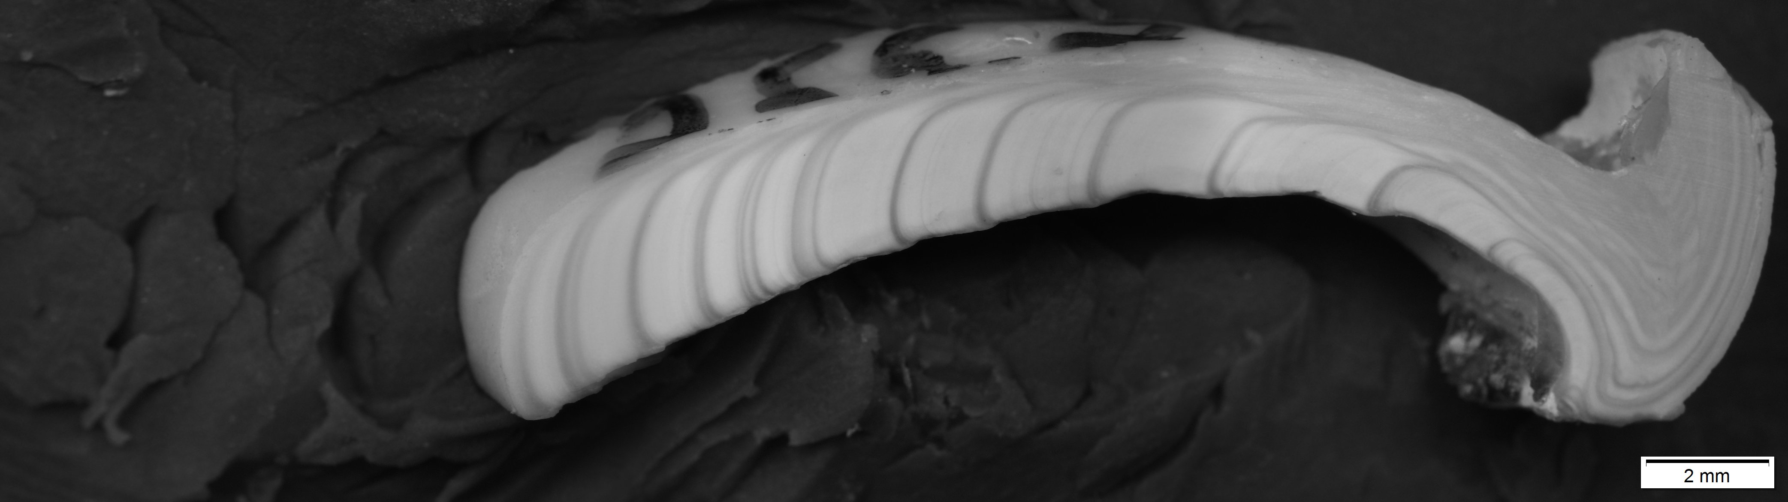
Manual Measurement Is Accurate but Time-Consuming
wide
narrow
Manual measurement is reliable, but difficult to scale.
Goal: use computer vision to automate ring counting and spacing measurement.
Notes:
Right now this is done by hand. Manual measurement is accurate and reliable, but it's slow and hard to scale to a lot of shells. So our goal is to use computer vision to automate both the ring counting and the spacing measurement.

Slide 4
Dataset Overview: Surf Clam Shell Images and Growth-Increment Labels
Image data
  More than 500 surf clam shell images
  Images collected from multiple years:
    1986, 2008, 2011, 2012, 2013, 2014, 2015, and 2016
Available labels
  Each labeled image is associated with a sequence of growth increments:
    I1, I2, I3, ..., In
  Each I value represents the distance between two adjacent growth rings
  These labels provide spacing measurements, not exact ring coordinates in the image
Pixel-to-mm conversion
  Pixel distances are given and they can be converted to millimeters
Notes:
or data, we have more than 500 shell images Now, collected across several years from 1986 up to 2016. Each labeled image comes with a sequence of growth increments — I-one, I-two, and so on — where each value is the distance between two adjacent rings. So the labels give us spacing, not the exact ring coordinates. We also have a pixel-to-millimeter conversion, so the measurements can be turned into real distances.

Slide 5
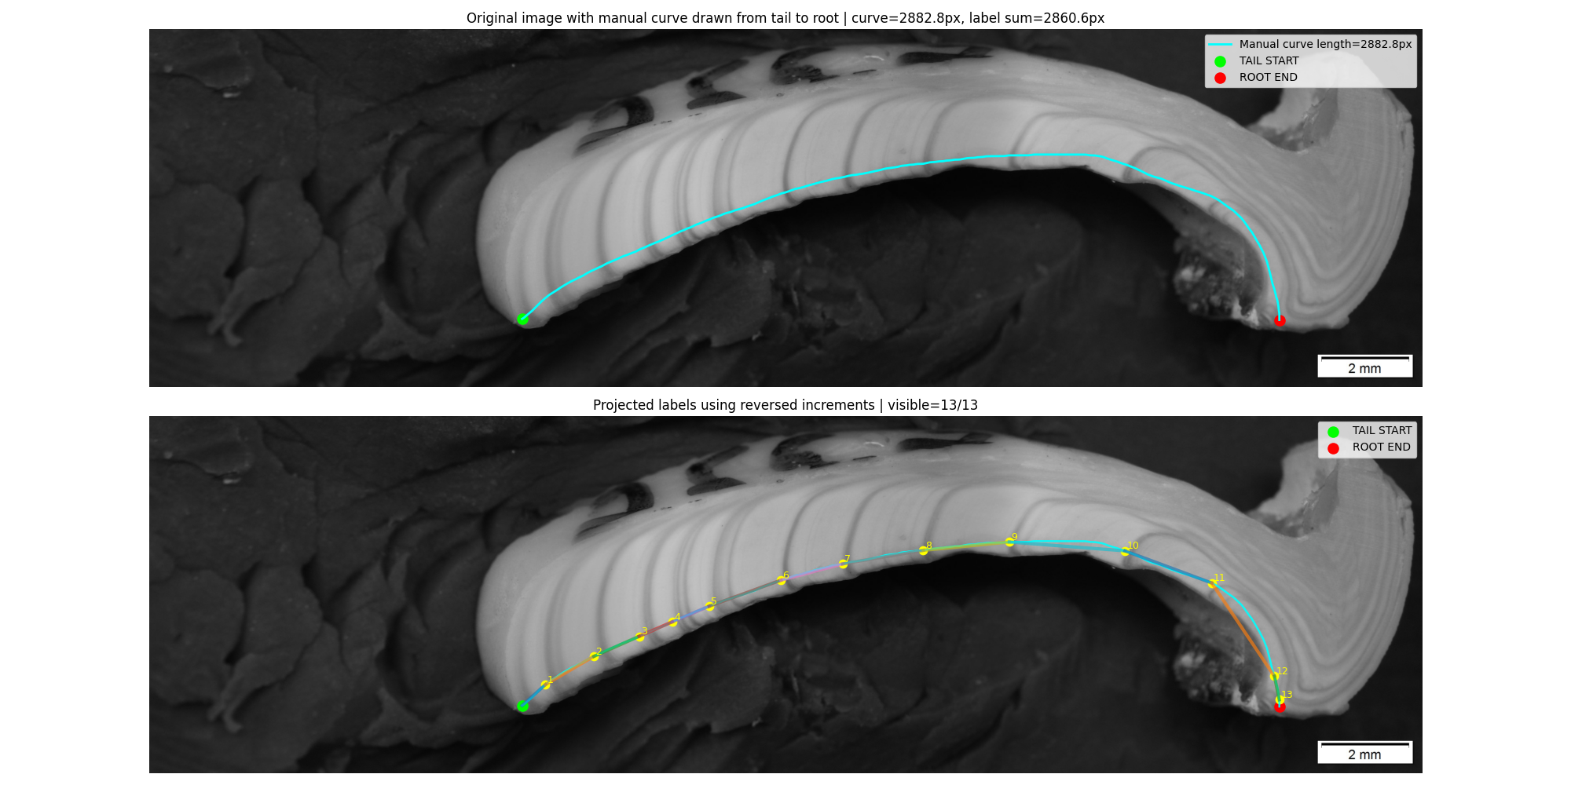
Understanding the Available Labels
Challenge:
  The labels do not include exact ring positions
  The start point and measurement path are not recorded
What I inferred:
  The spacing likely follows a curved path along the shell edge
  Based on our test, the biological order appears to be from root/hinge to tail
The first challenge is to align them with the correct image path and direction.
Notes:
The tricky part is that the labels don't tell us where the rings actually are in the image. I don't know the start point or the exact path used to measure. From my tests, the spacing seems to follow a curved path along the shell edge, and the biological order runs from the hinge to the tail. So your first challenge is just aligning these numbers with the right path and direction on the image.

Slide 6
Challenge 2: Limited Training Data
Only a small number of labeled images are available, making it difficult to train a dedicated deep learning model.
Instead, the model needs to infer growth-ring patterns from visual cues such as texture, contrast, and shell structure automatically.
Notes:
The second challenge is data. We only have a small number of labeled images, which isn't enough to train a dedicated deep learning model. So instead, the method has to read the ring patterns from visual cues directly — things like texture, contrast, and shell structure — without learning from a big labeled set.

Slide 7
Challenge 3: Image-Level Difficulties
Rings are densely packed near the root/hinge region
Large black background areas can interfere with detection
Ring visibility is inconsistent: some rings are dark and clear, while others are faint
Fake rings, weak rings, and shell cracks make growth-ring detection difficult.
Notes:
The third challenge is the images themselves. Rings get very dense near the hinge. There are large black background areas. And ring visibility is inconsistent — some are dark and clear, others are very unclear On top of that, there are fake rings, weak rings, and cracks, which all make detection harder.

Slide 8
Current Workflow
Segment the shell region
Model: FastSAM
Enhance ring visibility
Algorithms: grayscale conversion + CLAHE
Define the measurement path (I draw the path manually)
Convert the image to a 1D signal
Extract gray-value profile along the measurement curve
Reduce signal noise
Algorithm: Gaussian filtering
Detect candidate growth rings
Algorithm: valley detection using scipy.signal.find_peaks
Notes:
This is the pipeline I'm using now, and it doesn't need any training. First I segment the shell region with FastSAM. Then I enhance the rings using grayscale conversion and CLAHE. I define a measurement path manually and turn the image into a 1D signal by reading gray values along that curve. I smooth it with a Gaussian filter, and finally detect the rings as valleys in that signal using find_peaks.

Slide 9
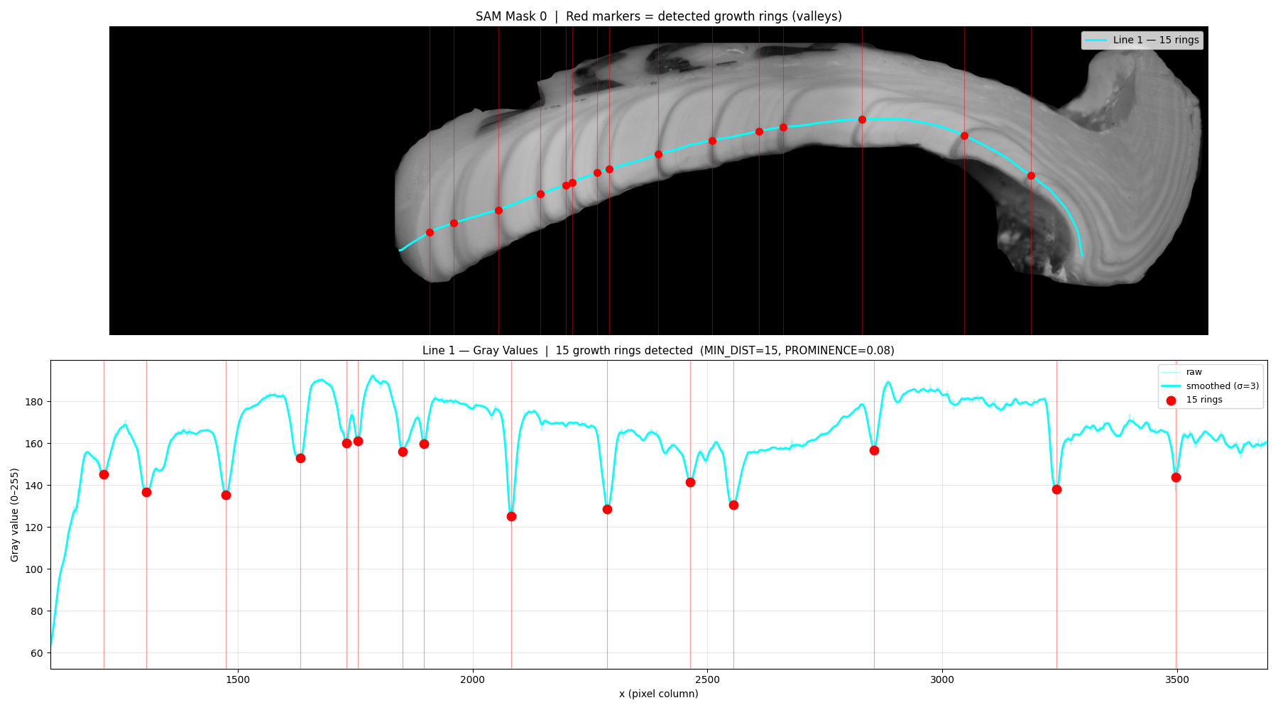
Results
Notes:
Here's a result. The cyan curve is the measurement path along the shell, and the red dots are the detected rings — fifteen here. The bottom plot is the 1D gray-value profile along that path, where each dark valley corresponds to a ring. You can see it works well where the rings are clear.

Slide 10
Other Potential Methods

Slide 11
Trying Large Models
Models to try
  VLMs: CHATGPT, Claude, Gemini, Qwen-VL
Possible problems
  Can‘t count dense / thin / faint rings reliably, still confused by fake rings
  No pixel-level position or accurate spacing
  Hallucination and non-reproducible results
Possible directions
  Quality triage: judge if rings are clear enough to measure
  Patch-level check: "true ring or crack/fake ring?" to clean up CV results
End-to-end baseline: VLM counts directly, as a comparison

Slide 12
Possible Solution Framework
Background Removal
  Problem:
  Images contain large black background areas and holes inside the shell.
Possible methods
  SAM / FastSAM
  Pretrained segmentation model for selecting the shell region.
  Python package: segment_anything / ultralytics
  Otsu’s Thresholding
  Automatically finds one global brightness cutoff.
  Python function: cv2.threshold(..., cv2.THRESH_OTSU)
  Mean / Gaussian Adaptive Thresholding
  Uses a local window to calculate a local cutoff, instead of one cutoff for the whole image.
  Python function: cv2.adaptiveThreshold()
  GrabCut
  Refines foreground/background separation from a rough box or mask.
  Python function: cv2.grabCut()

Slide 13
Possible Solution Framework
Measurement Path Detection
Possible methods:
  Manual curve drawing
  Use the shell mask outline as the path
  After background removal, the shell becomes a binary mask. The outer border of this mask can be used as a candidate path.
  Method: cv2.findContours()
  Use visible shell edges as path candidates
  Instead of using a mask, detect strong visual boundaries directly from the original image, such as the boundary between the shell and the black background.
  Methods: cv2.Canny(), cv2.Sobel()
  Extract a centerline from the shell mask
  Convert the shell region into a thin middle line, then use this line as a possible measurement path.
  Methods: skimage.morphology.skeletonize(), medial axis transform

Slide 14
Possible Solution Framework
Ring Pattern Enhancement
Possible methods:
  CLAHE contrast enhancement
  Makes weak local patterns more visible.
  Function: cv2.createCLAHE()
  Background illumination correction
  Removes uneven brightness across the shell before ring detection.
  Possible methods: Gaussian blur background subtraction, rolling-ball correction
  Gabor filtering
  Enhances repeated stripe-like textures.
  Function: cv2.getGaborKernel()
  Frangi / Hessian filtering
  Enhances thin curved line-like structures.
  Package: skimage.filters.frangi

Slide 15
Possible Solution Framework
Ring Candidate Detection
Possible methods:
  Brightness profile valley detection
  Convert the curve into a 1D gray-value signal, then detect dark valleys as possible rings.
  Method: scipy.signal.find_peaks(-gray_signal)
  Gradient peak detection
  Detect positions where brightness changes sharply along the curve.
  Methods: np.gradient(), cv2.Sobel()
  Canny edge detection along the path
  Detect strong edge responses near the measurement curve.
  Method: cv2.Canny()
  Local minima detection
  Directly find low-brightness points in the smoothed 1D profile.
  Methods: scipy.signal.argrelextrema(), find_peaks(-signal)

